Slide 1

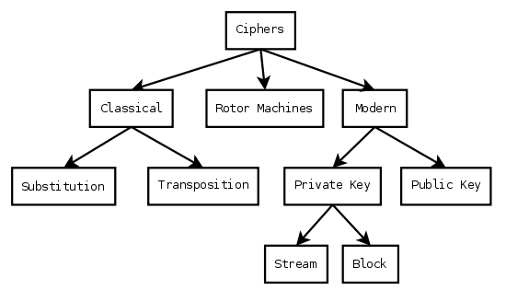

Slide 2
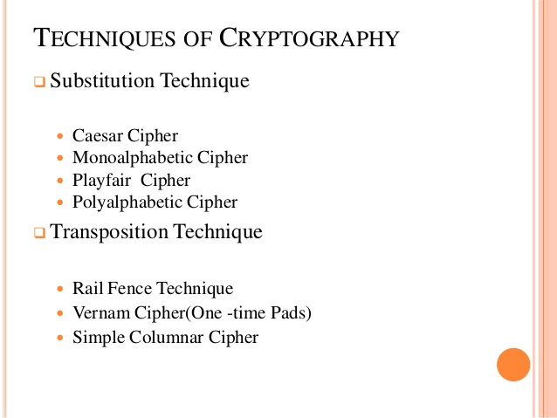

Slide 3
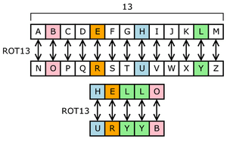
Rotor Machines

Slide 4

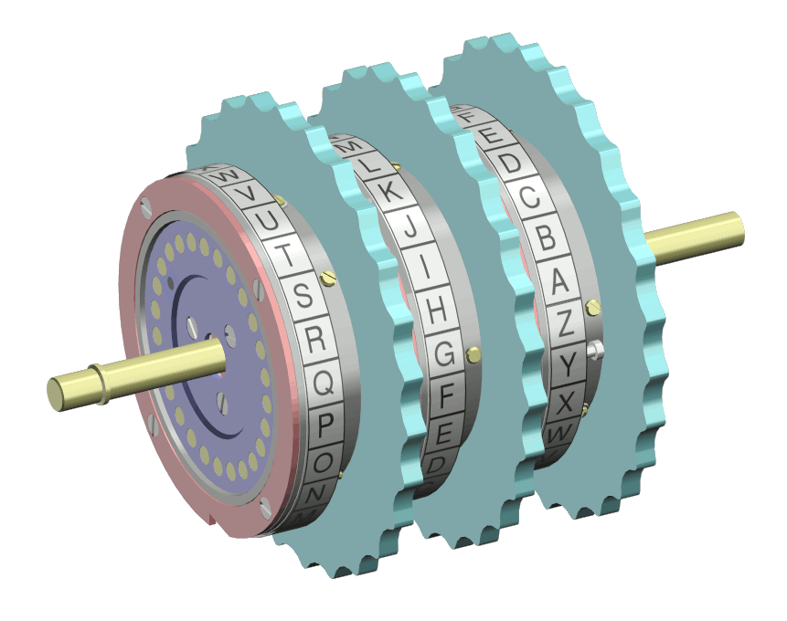
4
Notes:
4

Slide 5

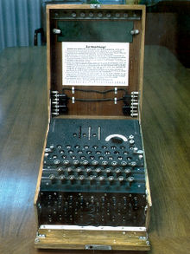
Enigma
  Machine to encrypt German communications in WWII
  Consisted of plug board, 3 rotors, and reflector board
  Each implemented a substitution
  Rotors shifted after each letter, so like Vigenere, but with period of about 16,900
Notes:
5

Slide 6
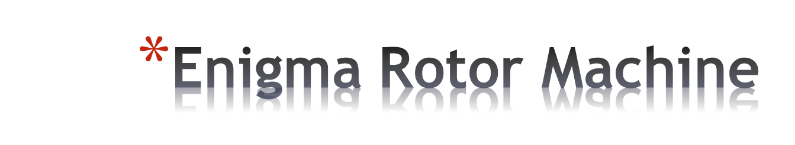
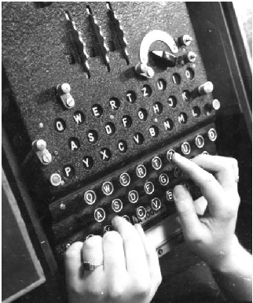
6
Notes:
6

Slide 7
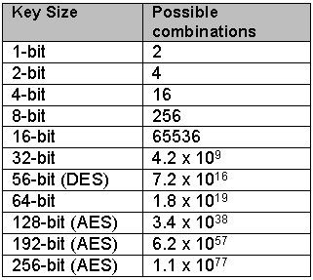
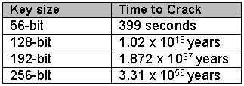

Slide 8
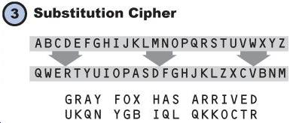

Slide 9
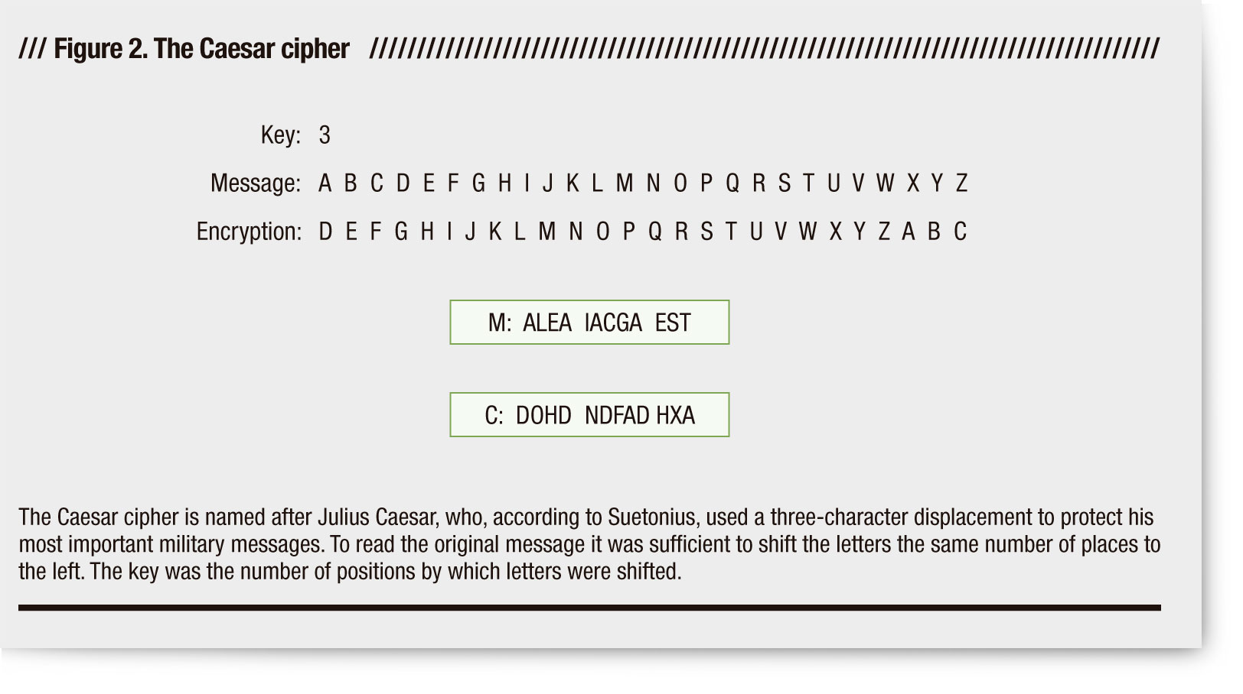
Shift Cipher(Caesar Cipher)

Slide 10
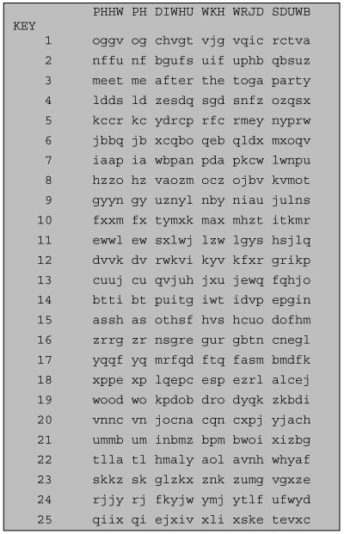
Brute Force Cryptanalysis of Caesar Cipher

Slide 11
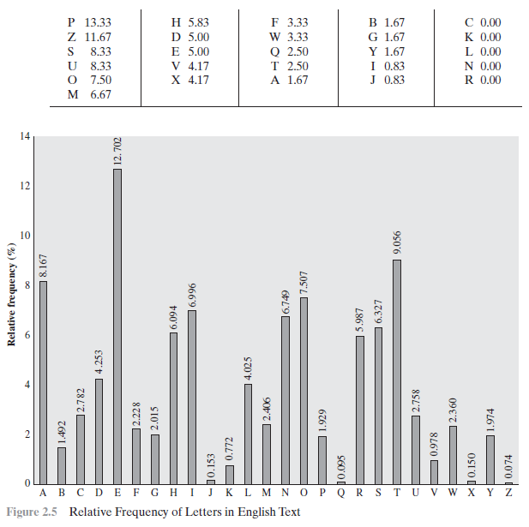

Slide 13

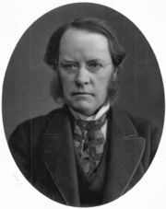
invented by Wheatstone on 26 March 1854,but it was promoted by Playfair
One approach to improving security is to encrypt multiple letters at a time.
Invented by Charles Wheatstone in 1854, but named after his friend Baron Playfair
Lord Playfair
Notes:
13
Despite its invention by Wheatstone, it became known as the Playfair cipher after Lord Playfair, who heavily promoted its use.
The first recorded description of the Playfair cipher was in a document signed by Wheatstone on 26 March 1854.

Slide 14
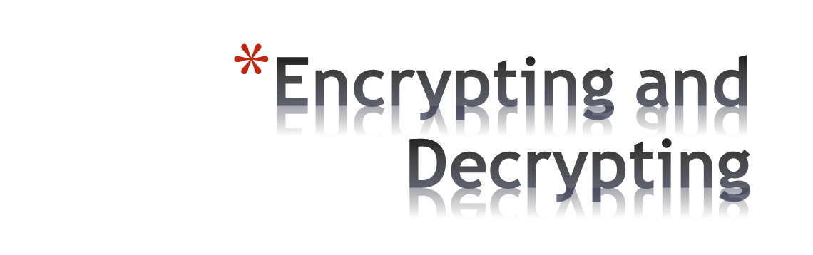
Plaintext is encrypted two letters at a time.
  If a pair is a repeated letter, insert filler like 'X’.
  If both letters fall in the same row, replace each with the letter to its right (circularly).
  If both letters fall in the same column, replace each with the letter below it (circularly).
  Otherwise, each letter is replaced by the letter in the same row but in the column of the other letter of the pair.
14
Notes:
14

Slide 15
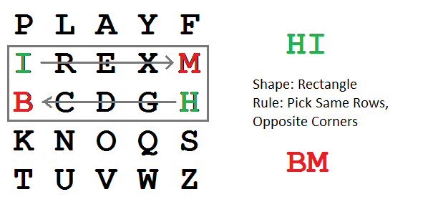

Slide 16
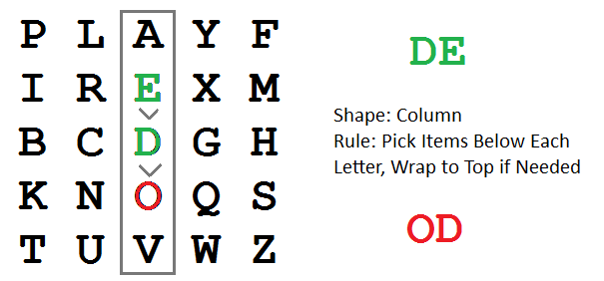

Slide 17
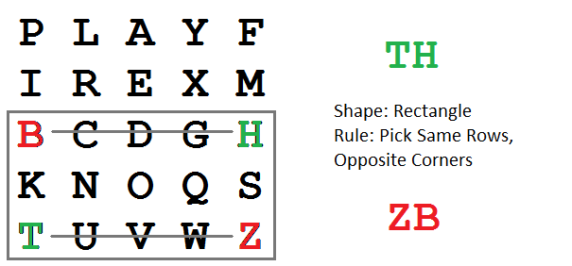

Slide 18
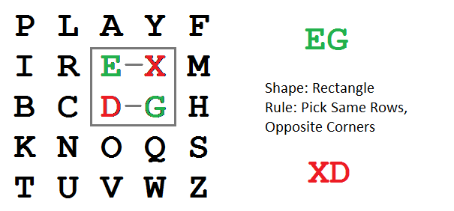

Slide 19
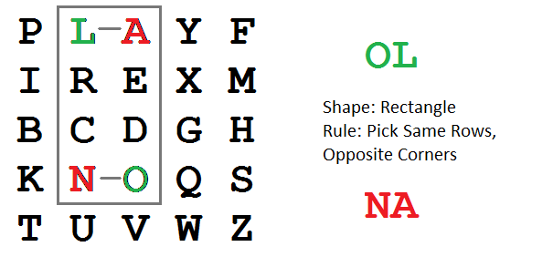

Slide 20
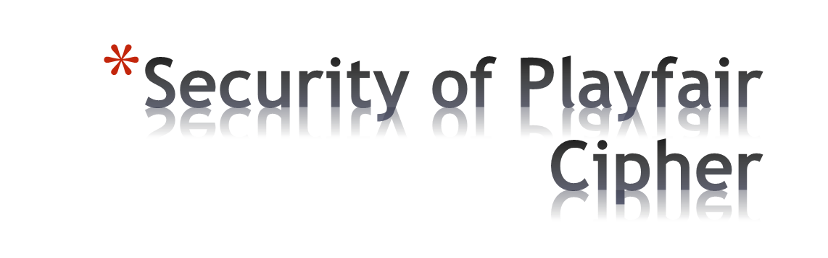
Equivalent to a monoalphabetic cipher with an alphabet of 26 x 26 = 676 characters.
Security is much improved over the simple monoalphabetic cipher.
Was widely used for many decades
  eg. by US & British military in WW1 and early WW2
Once thought to be unbreakable.
Actually, it can be broken, because it still leaves some structure of plaintext intact.
20
Notes:
20

Slide 22
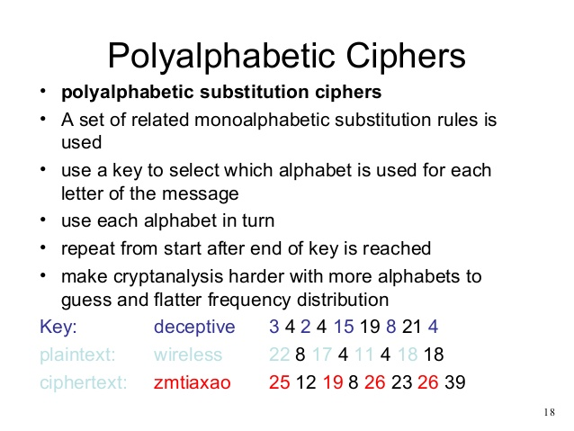

Slide 23
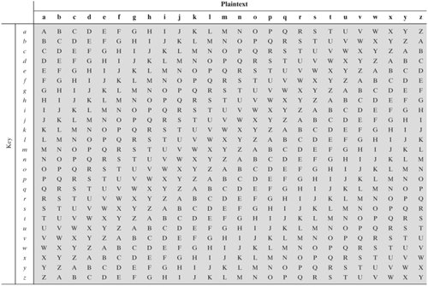
Polyalphabetic cipher(Vigenere cipher)

Slide 24
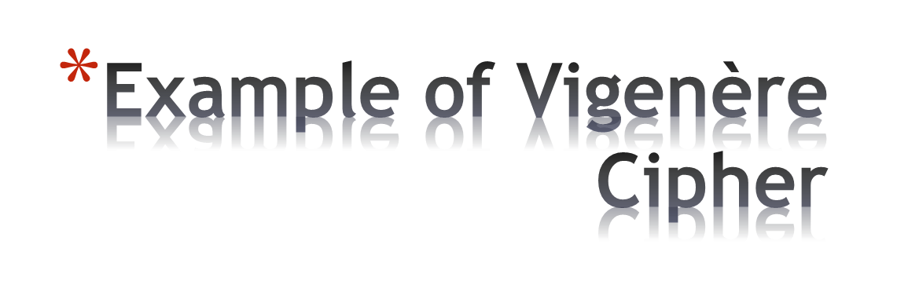
Keyword: deceptive
  key: deceptivedeceptivedeceptive
  plaintext: wearediscoveredsaveyourself
  ciphertext: ZICVTWQNGRZGVTWAVZHCQYGLMGJ
24
Notes:
24

Slide 25
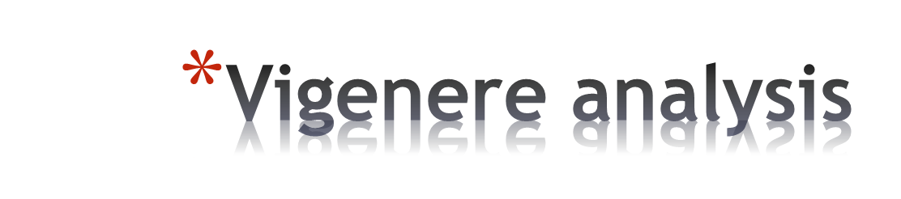
Key space?
  26^{Length(Key)}
  10-20 characters to prevent brute force on modern computers
Frequency analysis?
  Doesn’t work because of different keys
Notes:
25

Slide 26

There are multiple (how many?) ciphertext letters
corresponding to each plaintext letter.
So, letter frequencies are obscured but not totally lost.
To break Vigenere cipher:
    Try to guess the key length. How?
    If key length is N, the cipher consists of N Caesar ciphers. Plaintext letters at positions k, N+k, 2N+k, 3N+k, etc., are encoded by the same cipher.
    Attack each individual cipher as before.
26
Notes:
26

Slide 27
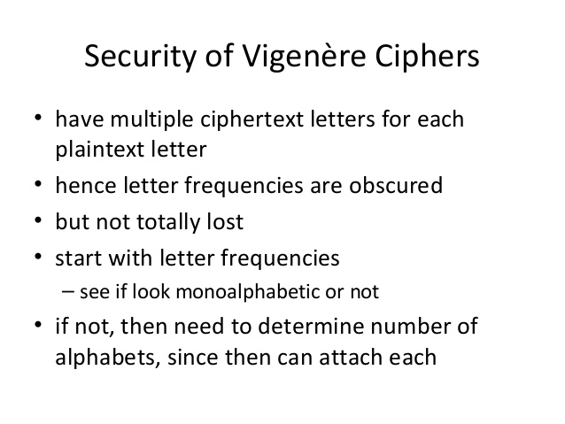

Slide 28
One time Pad(Improvement of vernam cipher)
An Army Signal Corp officer – Joseph Mauborgne proposed an Improvement to vernam cipher that yields the ultimate in security
Suggested using a random key that was truly as long as the message with no repetitions.
One time pad is unbreakable
It produces random output with no statistical relationship to the plaintext.

Slide 29

if a truly random key as long as the message is used, the cipher will be secure
called a One-Time Pad
is unbreakable since ciphertext bears no statistical relationship to the plaintext
since for any plaintext & any ciphertext there exists a key mapping one to other
can only use the key once though
have problem of safe distribution of key
Notes:
29
The One-Time Pad is an evolution of the Vernham cipher, which was invented by Gilbert Vernham in 1918, and used a long tape of random letters to encrypt the message. An Army Signal Corp officer, Joseph Mauborgne, proposed an improvement using a random key that was truly as long as the message, with no repetitions, which thus totally obscures the original message.
Since any plaintext can be mapped to any ciphertext given some key, there is simply no way to determine which plaintext corresponds to a specific instance of ciphertext.

Slide 30
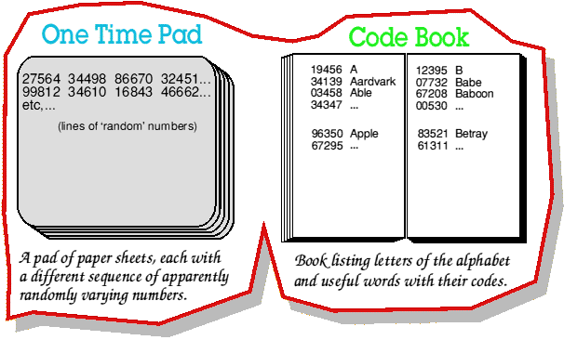

Slide 31
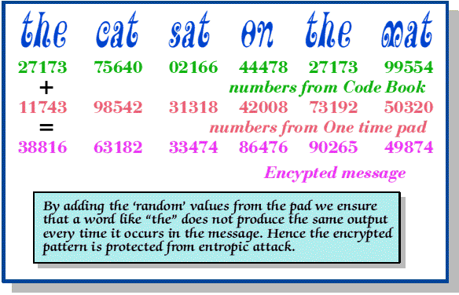

Slide 32
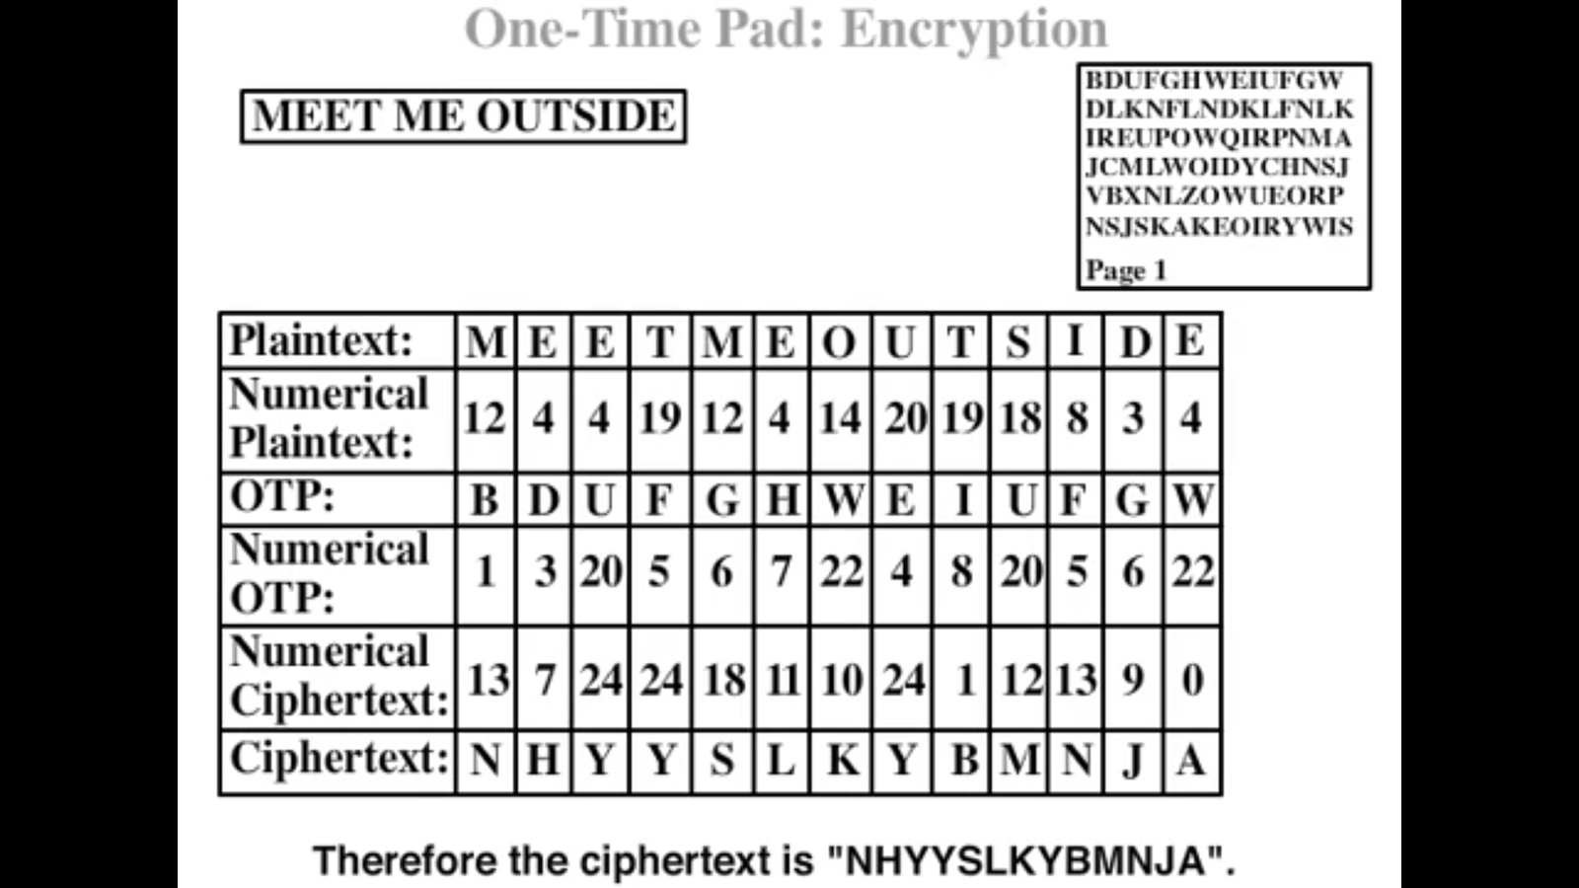

Slide 34
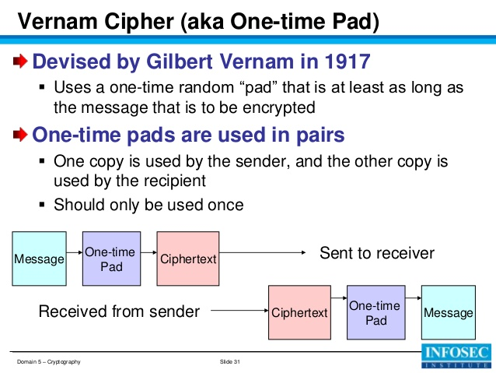

Slide 35
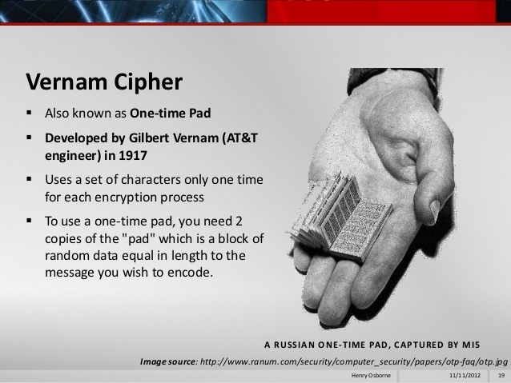

Slide 36
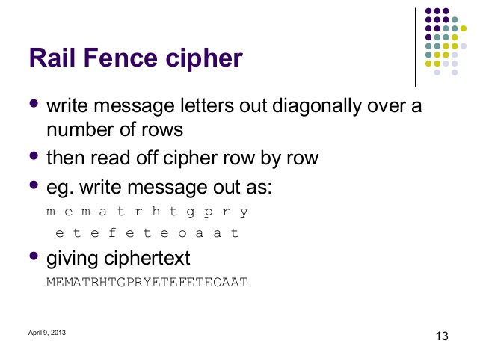

Slide 37
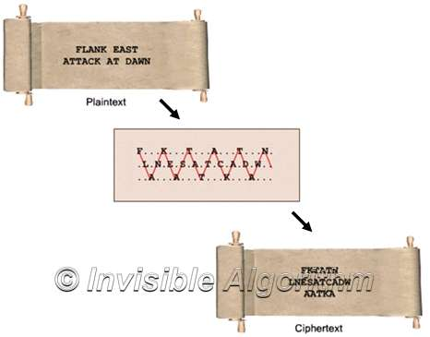
Cryptography, Jerzy Wojdylo, 5/4/01

Slide 38
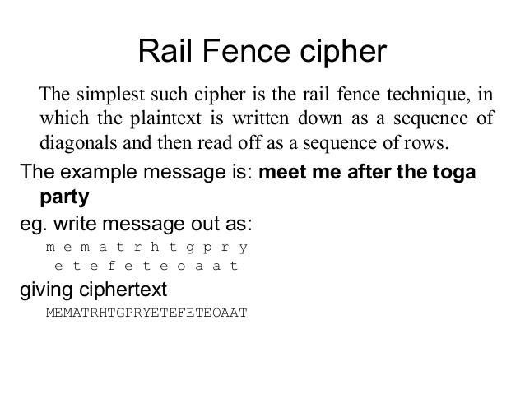

Slide 39
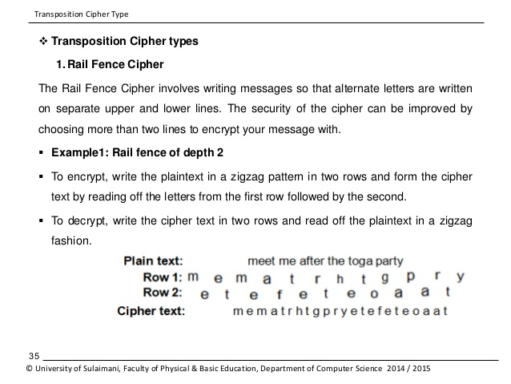

Slide 40
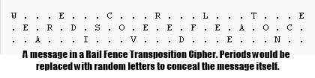

Slide 41
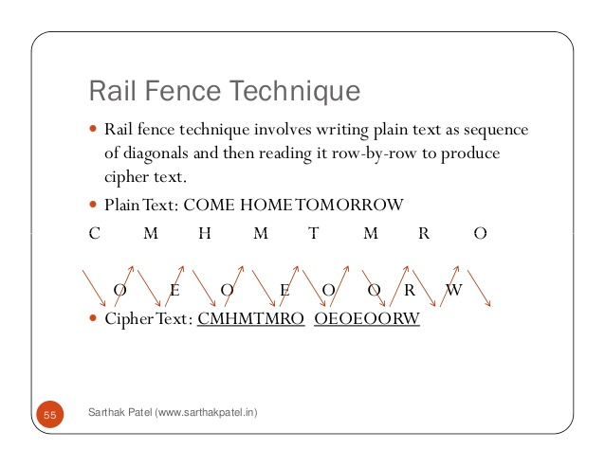

Slide 42

Plaintext is written row by row in a rectangle.
Ciphertext: write out the columns in an order specified by a key.
  Key: 3 4 2 1 5 6 7
  Plaintext:
  Ciphertext:
  TTNAAPTMTSUOAODWCOIXKNLYPETZ
a | t | t | a | c | k | p
o | s | t | p | o | n | e
d | u | n | t | i | l | t
w | o | a | m | x | y | z
42
Notes:
42

Slide 43
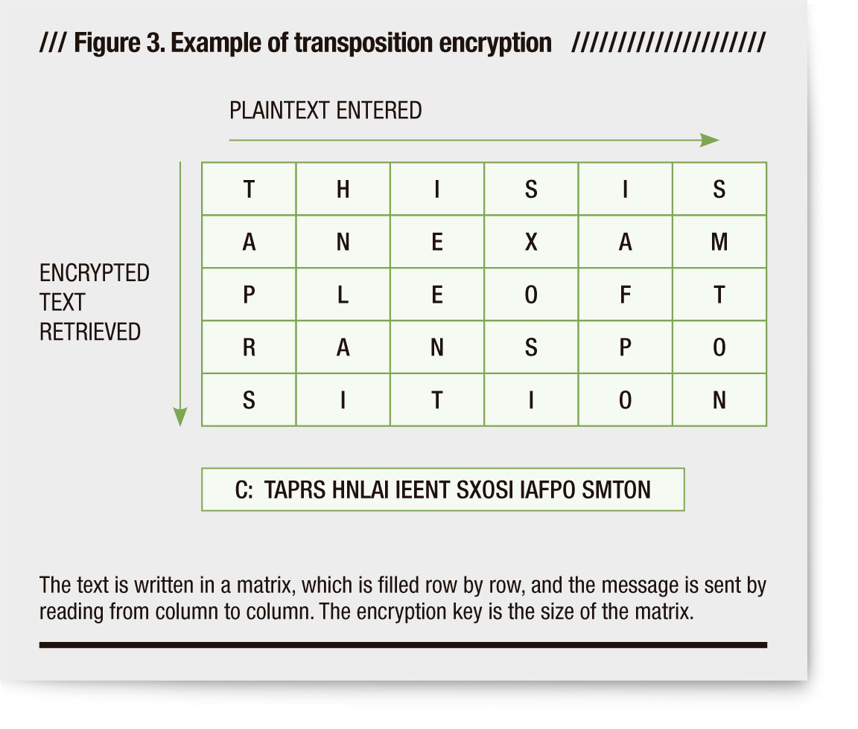
Row transposition cipher

Slide 44
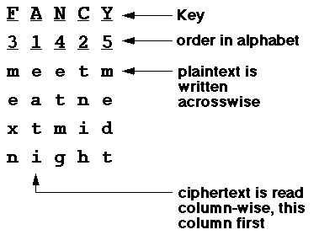
In this system, the order of the plaintext characters is changed, but the characters themselves are not -- that is, the encrypted message contains all the same characters as the plaintext. For example, a simple columnar cipher is:
the ciphertext is:EATITNIHMEXNETMGMEDT

Slide 45
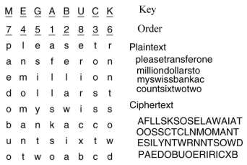

Slide 46
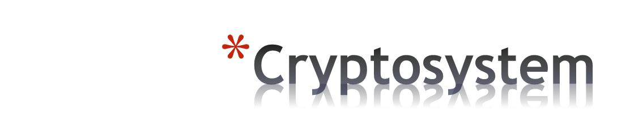
A cryptosystem is a five-tuple (P,C,K,E,D), where the following are satisfied:
P is a finite set of possible plaintexts
C is a finite set of possible ciphertexts
K, the keyspace, is a finite set of possible keys
∀K∈K, ∃e_{K}∈E (encryption rule), ∃d_{K}∈D (decryption rule).
Each e_{K}: P→C and d_{K}: C→P are functions such that ∀x∈P, d_{K}(e_{K}(x)) = x.

Slide 47

English alphabet
Lower case: a, b, c,…, z for plaintext
Upper case: A, B, C,…, Z for ciphertext
For encryption and decryption algorithms, we will substitute letters a, b, c,…, z with numbers 0, 1, 2,…, 25.

Slide 48

Monoalphabetic Ciphers
Once a key is chosen, each alphabetic character of a plaintext is mapped onto a unique alphabetic character of a ciphertext.
  The Shift Cipher (Caesar Cipher)
  The Substitution Cipher
  The Affine Cipher

Slide 49

Polyalphabetic Ciphers
Each alphabetic character of a plaintext can be mapped onto m alphabetic characters of a ciphertext. Usually m is related to the encryption key.
  The Vigenère Cipher
  The Hill Cipher
  The Permutation Cipher

Slide 50

Monoalphabetic cipher
  Caesar cipher
Polyalphabetic cipher
  Vigenère cipher
Multiple letter cipher
  Playfair cipher
50

Slide 51
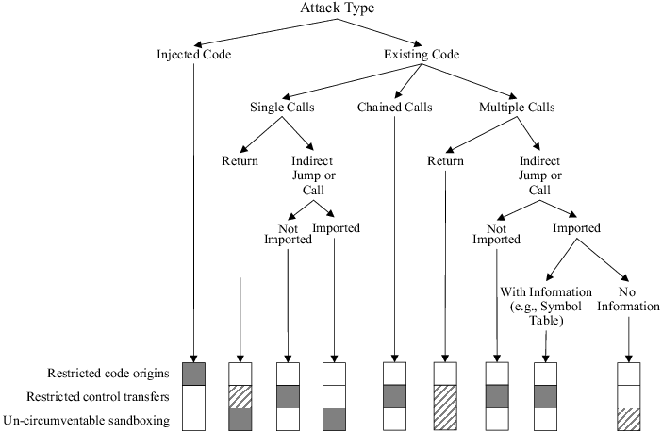

Slide 52
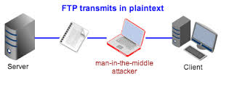
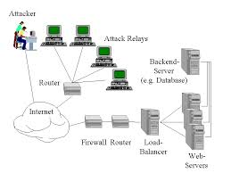
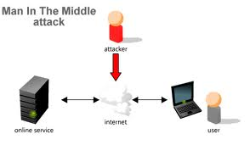
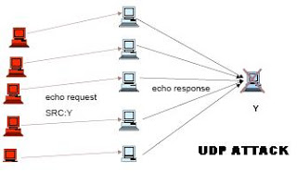
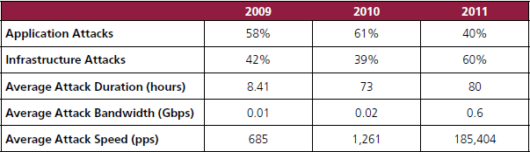

Slide 53
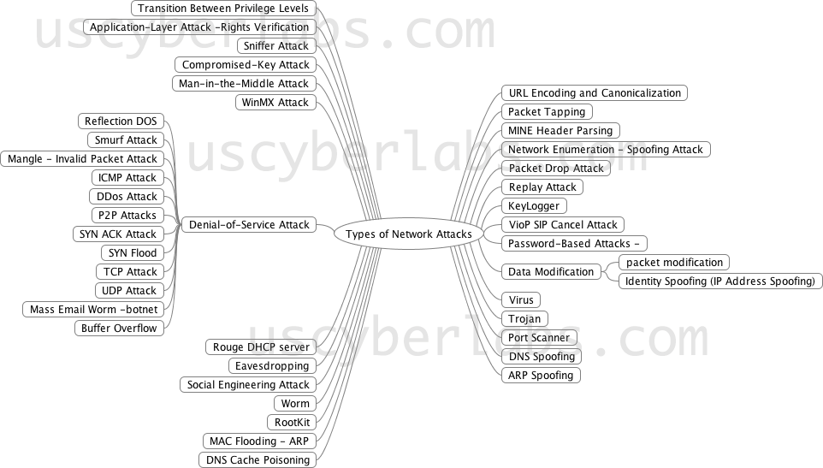

Slide 54
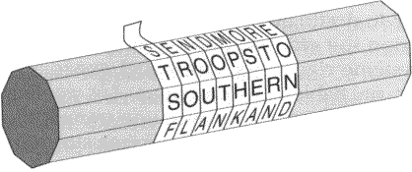
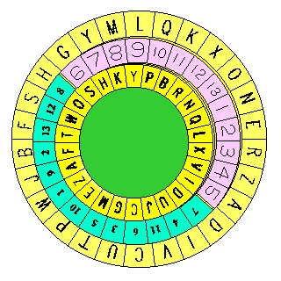

Slide 55

Hide a message in another message.
E.g., hide your plaintext in a graphic image
  Each pixel has 3 bytes specifying the RGB color
  The least significant bits of pixels can be changed w/o greatly affecting the image quality
  So can hide messages in these LSBs
Advantage: hiding existence of messages
Drawback: high overhead
55
Notes:
55

Slide 56


Greek Words:
STEGANOS – “Covered”
GRAPHIE – “Writing”
Steganography is the art and science of writing hidden messages in such a way that no one apart from the intended recipient knows of the existence of the message.
This can be achieve by concealing the existence of information within seemingly harmless carriers or cover
Carrier: text, image, video, audio, etc.
Stegosaurus: a covered lizard
(but not a type of cryptography)

Slide 57

Take a 640x480 (=30,7200) pixel image.
Using only 1 LSB, can hide 115,200 characters
Using 4 LSBs, can hide 460,800 characters.
57

Slide 58
an alternative to encryption
hides existence of message
  using only a subset of letters/words in a longer message marked in some way
  using invisible ink
  hiding in LSB in graphic image or sound file
has drawbacks
  high overhead to hide relatively few info bits

Slide 59

59
Notes:
59

Slide 60
Enigma
  Machine to encrypt German communications in WWII
  Consisted of plug board, 3 rotors, and reflector board
  Each implemented a substitution
  Rotors shifted after each letter, so like Vigenere, but with period of about 16,900
Notes:
60

Slide 61
61
Notes:
61

Slide 62

E.g. ENIGMA MACHINE. Polyalphabetic Cipher
Several interconnected substitution rotating cylinders.
Example:
Input Rotor1 Rotor2 Rotor3 Output
A A->F F->X X->N N
Rotor 3 now shifts (its substitutions change)
A A->F F->X X->W W
Rotor 3 now shifts (its substitutions change)
... After 26 shifts by Rotor 3, it will be back to its original, substitution Rotor 2 now shifts.
A A->F F->B B->S S
With 3 rotors and 26 letters we have a period = 26^3(26 power of 3) = 17,576 substitution alphabets

Slide 63
ROTOR MACHINES
Combine Substitution and Transposition Methods
• produce ciphers that are very difficult to break
Rotor Machines in World War II: German “Enigma” and Japanese “Purple”
• Breaking by the Allies was a significant factor in the outcome of the war (Turing)
8. Cryptography part 2
63

Slide 64


8. Cryptography part 2
64

Slide 65

Before modern ciphers, rotor machines were most common complex ciphers in use.
Widely used in WW2.
Used a series of rotating cylinders.
Implemented a polyalphabetic substitution cipher of period K.
With 3 cylinders, K = 26³ =17,576.
With 5 cylinders, K = 26⁵ =12 x 10⁶.
What is a key?
  If the adversary has a machine
  If the adversary doesn’t have a machine
65
Notes:
65

Slide 66

66

Slide 67

There are two major branches of information hiding, Steganography and Watermarking
Watermarking:
  Communication in watermarking is the host signal, with the embedded data providing copyright protection.
  The existence of a watermark is often declared openly.
  Any attempt to remove or invalidate the embedded content renders the host useless.
Cryptography:
  Doesn’t conceal the communication.
  Scrambles the data to prevent eavesdroppers understanding the content.
  Cryptography involves various methods and implementations.
  May be considered complementary and orthogonal (unrelated).
Once the presence of hidden information is revealed or even suspected, the purpose of steganography is defeated.

Slide 68

A cryptosystem is computationally secure if the best algorithm for breaking it requires at least N operations, where N is some specified , very large number.
Problems…
A cryptosystem is unconditionally secure if it cannot be broken with infinite computational resources.

Slide 69
None of the classical cryptosystems is even computationally secure.
However the Shift Cipher, the Substitution Cipher, and the Vigènere Cipher are unconditionally secure if only one element of plaintext is encrypted with a given key!
REALLY???

Slide 70
Claude Shannon “Communication Theory of Secrecy Systems”, Bell Systems Technical Journal, (1949) .
A cryptosystem has perfect secrecy if p_{P}(x|y) = p_{P}(x) for any x∈P and y∈C. That is the a posteriori probability that the plaintext is x, given that the ciphertext is y, is identical to the a priori probability that the plaintext is x.

Slide 71
Theorem (Shannon). Suppose the 26 keys in the Shift Cipher are used with equal probability 1/26. Then for any plaintext probability distribution, the Shift Cipher has perfect secrecy.
Consequences: One-time Pad Cryptosystem (Gilbert Vernam, 1917). Key, plaintext, and ciphertext have the same length.
Problems with keys: very long, distribution. Each key can be used only ONCE!

Slide 72


Slide 73
if a truly random key as long as the message is used, the cipher will be secure
called a One-Time Pad
is unbreakable since ciphertext bears no statistical relationship to the plaintext
since for any plaintext & any ciphertext there exists a key mapping one to other
can only use the key once though
have problem of safe distribution of key
Notes:
73
The One-Time Pad is an evolution of the Vernham cipher, which was invented by Gilbert Vernham in 1918, and used a long tape of random letters to encrypt the message. An Army Signal Corp officer, Joseph Mauborgne, proposed an improvement using a random key that was truly as long as the message, with no repetitions, which thus totally obscures the original message.
Since any plaintext can be mapped to any ciphertext given some key, there is simply no way to determine which plaintext corresponds to a specific instance of ciphertext.

Slide 76

OTP takes a string of random numbers as long as the message
Combines the random numbers with the message
  XOR, modular or rotational arithmetic good ways
This produces cyphertext
Because all random strings are equally likely, cryptanalysis is impossible

Slide 77

Message: ATTACK
Pad (key): 4 8 20 10 16 1
Cyphertext: EAMKSL
But what if the pad was 25 15 11 10 16 1
Message is FLBACK
This is why it’s unbreakable

Slide 78

But what longer messages?
  You need a longer pad
  You need a lot of pad
  You need a pad for every person you want to talk to.
  You must never lose a pad
  This takes work
  Cryptographic random numbers are not like other random numbers

Slide 79



